Slide 1
Kuali Financial System (KFS) Transactional Edocs
Types and Purposes for Various KFS Edocs

Slide 2
Agenda
Basic Accounting Concepts
KFS Transactional Edocs
Types and Purposes
Action Item Buttons
Workflow and Routing
Search Functionality

Slide 3
Basic Accounting Concepts
FOLLOW THE CASH
Balance Sheet and Income Statement
Why debits and credits matter
Increase to cash is a debit!

Slide 4
Balance Sheet
 | What I own |  | What I owe |  | What I’m worth
 | ASSETS | - | LIABILITIES | = | FUND BALANCE
Example How Do I… | Cash Object Code 1100 |  | Invoices Payable Object Code 2055 |  | Equity - Fund Balance Object Code 3037
Increase | Debit |  | Credit |  | Credit
Decrease | Credit |  | Debit |  | Debit
Income Statement
 | What I earn |  | What I spend |  | What I have left
 | INCOME | - | EXPENSES | = | (INCREASE IN) FUND BALANCE
Example How Do I… | Other Income Object Code 4050 |  | Supplies Object Code 6428 |  | Equity - Fund Balance Object Code 3037 Recorded at Period 13 only
Increase | Credit |  | Debit |  | Credit
Decrease | Debit |  | Credit |  | Debit

Slide 6
KFS Transactional Edocs
Types and Purposes
Case Study Examples
Document Workflow and Routing
Search Functionality

Slide 7
Types and Purposes
Disbursement Voucher
Transfer of Funds
Budget Reallocation/Adjustment
Distribution of Income/Expense
General Error Correction
Intra-Account Adjustment
Internal Billing
Cash Receipt
Non-Check Disbursement
Advance Deposit

Slide 8
Disbursement Voucher (DV)
Purpose
Used to facilitate a payment for items that do not require a Purchase Order (PO) or cannot be paid for via an MSU payment card (PCard, Travel or Event card).
Examples include:
Non-travel employee reimbursement
Honoraria
Certain services/supplies under $2500
Royalties
Refunds
Subscriptions
See section 75 of the Manual of Business Procedure for full details. MSU Manual of Business Procedures - Section 75

Slide 9
Disbursement Voucher (DV)

Slide 10
DV Quick Tips
Use the correct Payment Reason Code.
Choose the correct Vendor.
Do NOT change the due date.
Provide a Business Purpose.
Use Check Stub Text so vendor can identify the payment.
Attach appropriate supporting documentation.

Slide 11
Transfer of Funds (TF)
Purpose
Used to transfer cash between accounts. Typically used to cover an overdraft, reimburse another account/department for an expense, or fulfill a funding commitment.
There are restrictions related to the funds used. There is a quick reference for allowable transactions
Transfer of funds Document -Quick Reference
Examples for use:
General Funds need to be moved to a Plant Fund account to provide funding for a renovation project. The funds will be moved on a Transfer of Funds document: FROM the General Fund account (object code 6101), TO the Plant Fund account (object code 4101).
Designated Fund account is sponsoring an event with another Designated Fund account. The funds will be moved on a Transfer of Funds document: FROM the account contributing (object code 6101), TO the account hosting the event (object code 4101).

Slide 12
TF Quick Tips
The object codes of 4101 and 6101 are used in transfer edocs only and 4100 and 6100 are for capital asset transfers only.
Provide a Business Purpose for the transfer.
Consult the Quick Reference chart to make sure you can transfer between certain accounts.
Check General Ledger Pending Entries before submitting. Follow the cash!

Slide 13
Transfer of Funds (TF)

Slide 14
Budget Adjustment/Reallocation(BA)
Purpose
Used to adjust or reallocation budget (not cash) among Board of Trustee approved appropriated(budgeted) accounts (General Fund and MSUE/AgBioResearch) or set up budgets in non-appropriated accounts (grants, auxiliary, non-credit instructions accounts, etc.).
Examples for use:
Move General Fund budget to another General Fund or MSUE/AgBioResearch account.
Set up or move budget in an XT account to track spending.
Sponsoring an event with between two General fund accounts.

Slide 15
BA Quick Tips
Use the object code where the budget is held or 7054 if unknown.
Provide a Business Purpose.

Slide 16
Budget Adjustment/Reallocation (BA)

Slide 17
Distribution of Income/Expense(DI)
Purpose
To distribute a previously posted revenue or expense. Typically, you would be moving it from one account to another because you are sharing or splitting the revenue or expense with another account or unit.
Examples for use:
An event is held, and costs are to be shared between two units. All expenses have been charged to one unit and a portion needs to be distributed to the other unit.
An account did not exist when you processed a Cash Receipt or Disbursement Voucher, and the revenue or expense needs to be moved.

Slide 18
DI Quick Tips
Sometimes used to “correct” where an item has been posted. A better edoc type would be a General Error Correction (GEC).
If only changing substring data (sub-account, sub-object code, project or org ref id) and Intra-Account Adjustment (IAA) should be used instead.
Typically using all revenue (starts with 4) or all expense (starts with 6) object codes.
Provide a Business Purpose.
Add support – typically an edoc number or operating statement.
Check General Ledger Pending Entries before submitting. Follow the cash!

Slide 19
Distribution of Income and Expense (DI)

Slide 20
General Error Correction (GEC)
Purpose
To correct the account or object code for a previously posted revenue or expense because an error was made.
Examples for use:
You forgot to change the default object code on a PCard edoc.
You were supposed to use a gift account for supply charges and used a General fund account instead.
A Service Billing or Service Provider billing posts automatically to an incorrect account.

Slide 21
GEC Quick Tips
If not correcting an error a better edoc type would be a Distribution of Income/Expense (DI).
If only changing substring data (sub-account, sub-object code, project or org ref id) and Intra-Account Adjustment (IAA) should be used instead.
Typically using all revenue (starts with 4) or all expense (starts with 6) object codes.
Provide a Business Purpose.
Add support – typically an edoc number or operating statement.
Check General Ledger Pending Entries before submitting. Follow the cash!

Slide 22
General Error Correction (GEC)
Reference Origin Code & Reference Number
Use the Reference Origin Code listed on the Operating Statement.
KFS transactions all have the code 01. Concur is 24. Service Billers may use other codes.
The Reference Number is the transaction document number listed on the Operating Statement.

Slide 23
Intra-Account Adjustment (IAA)
Purpose
To correct substring account data on a previously posted entry. Does not route to Central Accounting.
Examples for use:
Any of the following needs to be added to a transaction after it has posted:
Sub-account
Sub- object code
Project
Org Ref Id

Slide 24
Intra Account Adjustment (IAA)

Slide 25
Internal Billing (IB)
Purpose
To bill a MSU account for services or supplies that your unit provided.
The Income object code needs to start with a 4 (typically 4050) and the Expense object code needs to start with a 6.
Examples for use:
Stores
Kellogg Center
Dairy Store
Diagnostic Lab
HR Services
Library Copies

Slide 26
IB Quick Tips
The Income object code needs to start with a 4 (typically 4050) and the Expense object code needs to start with a 6.
Provide a Business Purpose. This is sometimes done by the billing department but may need to be added by the department being charged (Kellogg, Stores, Dairy Store, etc.)
Be sure Manual of Business Procedures policy is followed (retirements, gifts, food, etc.)

Slide 27
Internal Billing (IB)

Slide 28
Error Correction Button
Purpose
Used to completely reverse an e-doc transaction.
Will create a new edoc that routes for approvals.
Will reference the edoc that is being corrected.
Can only be used during the same fiscal year.
Since it will completely reverse an edoc it should not be used if you just need to correct one or two lines of an edoc with many lines.

Slide 29
Error Correction Button

Slide 30
Cash Receipt (CR)
Purpose
To facilitate cash/checks deposited with Cashiers and posting to the General Ledger/Operating Statement.
Once the CR has been submitted it cannot be edited. Cashier’s can disapprove if ENROUTE or the unit can submit a correcting entry (GEC) if it has gone final.
Attachments are not reviewed by Cashier’s so be sure all sensitive data (banking info on checks, SSN’s, etc.) has been redacted.
Cashier’s only confirm whether the cash/checks received match to the deposit total.

Slide 31
CR Quick Tips
Use an Income object code (starts with a 4-typically 4050) for revenue.
Cannot post income to a General Fund account.
For an expense abatement, meaning that funding has been provided to offset an expense (refund, cost share, etc.) you would use an Expense object code with a negative amount- otherwise document will indicate that it is “out of balance”.
See section 15 of the MBP for information on cash handling, deposits and incoming electronic funds.

Slide 32
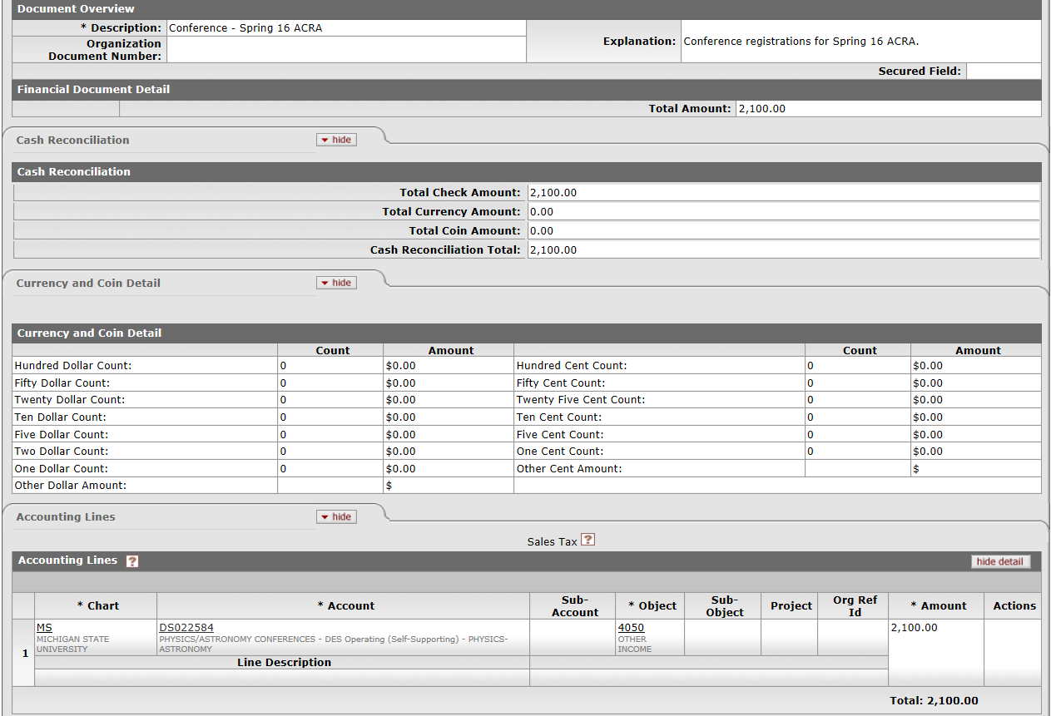
Cash Receipt (CR)

Slide 33
Non-Check Disbursement (ND)
Purpose
To record outgoing cash entries for transactions that are not processed via KFS, such as direct wires and ACH’s.
Examples for use:
Debt payments by Treasury and Financial Services
Tax payments by Tax Services
Food Stores vendor payments
Withholding payment by Payroll
HR benefit invoices

Slide 34
Non-Check Disbursement (ND)

Slide 35
Advance Deposit (AD)
Purpose
To record incoming cash entries for transactions that are not processed via KFS Cash Receipt, such as EFT’s and ACH’s.
Examples for use:
Spartan Cash
Investment income
Credit card sales
Federal/State grant income

Slide 36
Advance Deposit (AD)

Slide 37
Helpful Resource
Sponsorship Processing – for supporting another unit’s event or expense.
AccountingQuickReferenceGuide.pdf (msu.edu)

Slide 38
Case Study Examples

Slide 39
Case Study #1
You have been asked to transfer $2000 from your general fund account (GA019898) into The Office of Study Abroad’s general fund account (GA012323) to support an upcoming event. Complete the accounting lines on the appropriate e-doc.
Case Study #2
You have been asked to give $1000 from your department’s DS029090 account to support an event that will be hosted by The Writing Center in four months. The money will be given to account DN022332. Complete the accounting lines on the appropriate e-doc.

Slide 40
Case Study #1: Budget Reallocation
GA019898
7054
$2,000
GA012323
7054
$2,000

Slide 41
Case Study #2: Transfer of Funds
DS029090
6101
$1,000
DN022332
4101
$1,000

Slide 42
Case Study #3
The Library needs to charge the English Department $300 for copies. The Library account is XT029898 and the English Department account is DS022323. Complete the accounting lines on the appropriate e-doc.
Case Study #4
A conference event was held last month by The College of Agriculture. Your unit is contributing $1000 toward the catering costs. The College of Agriculture paid the catering bill on account RA071234 and your unit is contributing with funds from account GA011234. Complete the accounting lines on the appropriate e-doc.

Slide 43
Case Study #3: Internal Billing
XT029898
4050
$300
DS022323
6558
$300

Slide 44
Case Study #4: Distribution of Income and Expense
RA071234
6212
$1,000
GA011234
6212
$1,000

Slide 45
Document Status
Initiated – started but not saved or submitted.
Saved – initiated and saved but not submitted.
Enroute – submitted and working through the workflow but not yet final.
Processed – final except that FYI, Acknowledge or Read Notes actions have not been taken. Transaction will post.
Final – all actions have been taken. Transaction will post.
Cancelled – document was cancelled after save and before submission.
Disapproved – document was disapproved along the workflow route log before becoming final

Slide 46
Action Buttons
Submit – this starts the document along its route log and approval path.
Save – used when you have started a document and need further information to finish it but don’t want to lose your work. Allows you to see the General Ledger Pending Entries and the Route Log.
Close – closes the document. If it has not been saved it will no longer exist.
Cancel – can only be used before you submit. If it wasn’t saved, it will no longer exist, otherwise status will be cancelled.
Copy – allows you to copy a document. Some items will be replicated but not all.
Reload – reopens the document from the last saved version in KFS.
Send ad hoc request – will notify person ad hoc’d to take action.
Approve – will take approval action for your role.
Disapprove – will take disapproval action and document will no longer be active.
Error Correction – only appears after document is final/processed. Will completely reverse transaction.

Slide 47
Workflow and Routing
Basic/Automatic Routing
Organizational Review Routing
Route Log Review

Slide 48
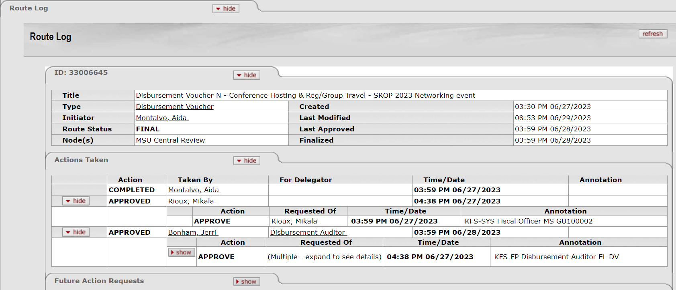
Basic Routing

Slide 49
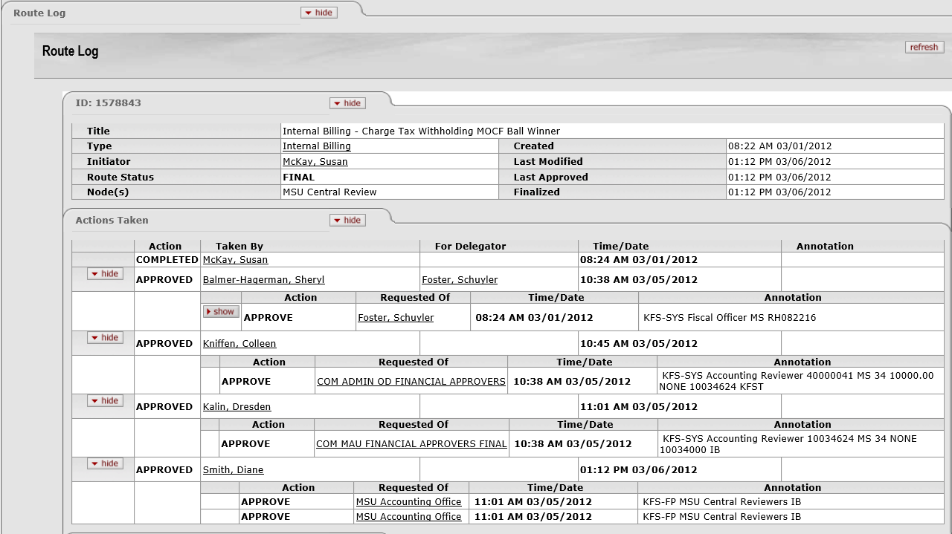
Organization Review Routing

Slide 50
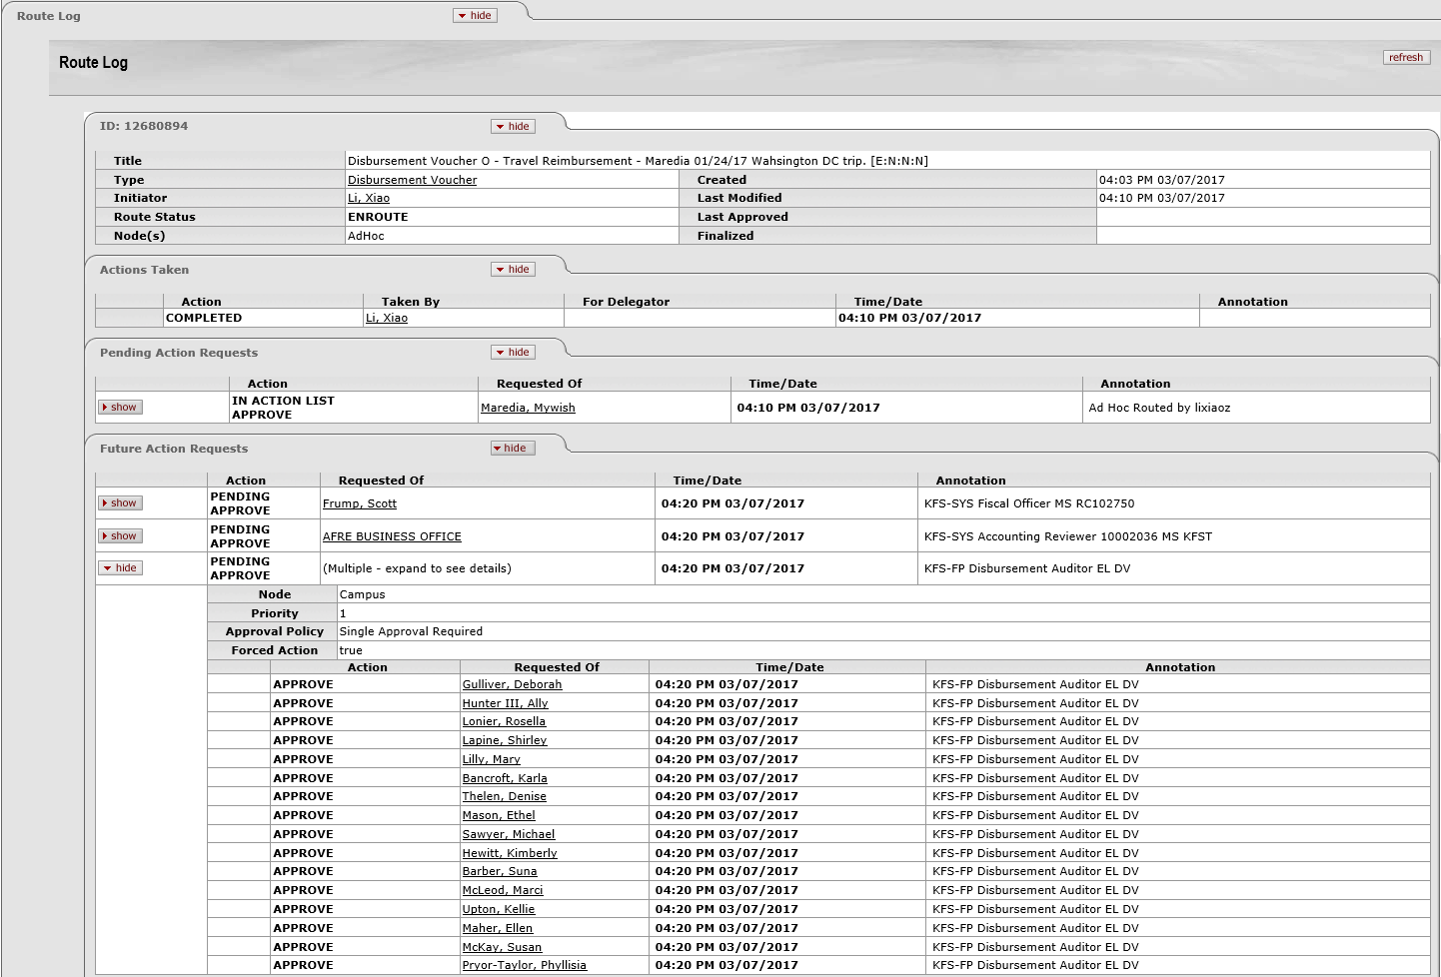
Enroute Document

Slide 51
Route Log Quick Tips
Review the route log to see who has or needs to take action on an edoc.
Groups only need to be approved by one in the group.
FYI, Acknowledge and Read Notes do not hold up workflow routing.
Action items for those no longer employed will need “superuser” approval. E-mail accounting@ctlr.msu.edu.

Slide 52
KFS Edoc Search Functionality

Slide 53
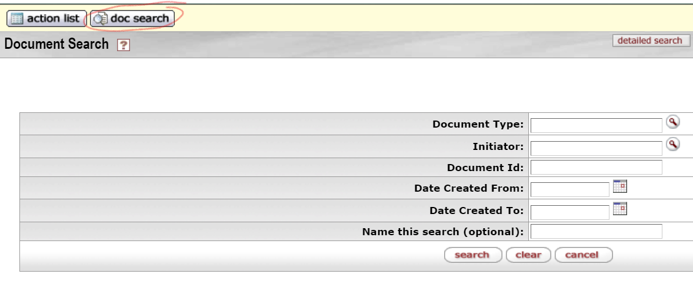
KFS Edoc Search Functionality
Doc Search button provides only basic search criteria options.
Search criteria options will change with the Document Type selected

Slide 54
KFS Edoc Search Functionality
Using detailed search button provides many search criteria options.
The options change based on the Document Type selected.
Use the search criteria to narrow your search as KFS will only return 500 results.

Slide 55
Detailed Document Search
To locate pending entries (reporting and closing an account):
Select Type: KFST
Select Status: Pending Statuses

Slide 56
Thank you for attending! Lauren Knoch kaiserl3@ctlr.msu.edu Phone: 884-4178 Accounting Office email accounting@ctlr.msu.edu Phone: 355-5000

