Slide 1
The Office of the Controller Presents
Vendors in KFS
Hosted by:
Lauren Knoch
Accounting Manager
kaiserl3@msu.edu
517-884-4178

Slide 2
Todays Topics
Types of vendors and how/when to use them
Searching for vendors
Vendor actions
  Editing an existing vendor
  Creating a division from an existing vendor
  Creating a new vendor

Slide 3
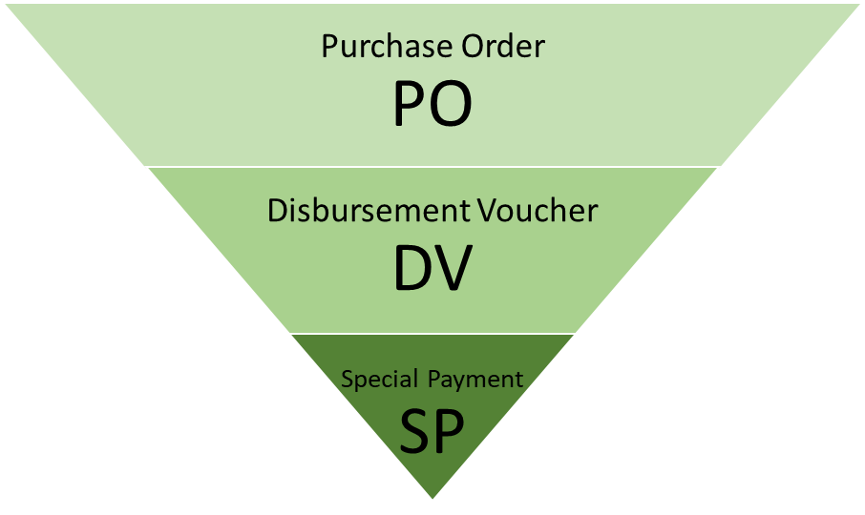
Hierarchy of Vendor Types
Vendor types have specific purposes and range from simple SP vendors to the more complicated PO vendors.
An additional vendor type are employee vendors that are created automatically via a Payroll SAP feed.

Slide 4
Vendor Types
Special Payment (SP)
    Vendors used for research participant payments ($150 or less), refunds, or non-employee reimbursements. Payment reason codes F, E, and I.
    Does not require a Tax ID.
    No attachments required (unless paying via wire)
Disbursement Voucher (DV)
    Vendors used for the purchase of goods or services not requiring a Requisition/PO. Consult with UPL-Procurement if unsure.
    Requires a Tax ID (SSN or EIN) – unless it is a foreign vendor.
    Attachments required (can only be seen by vendor approvers)
      W-9 for entities, recommended for individuals but not required
      W-8BEN or W-8BEN-E for foreign vendors
      Support for address addition or change
    Inactivate SP vendor if creating a DV vendor - cannot be “changed” to a DV vendor.

Slide 5
Vendor Types - continued
Purchase Order (PO)
    Created by Procurement when processing a Requisition – either from scratch or by changing a DV vendor to a PO vendor.
    Required documents are handled by Procurement – EIN now required.
    PO vendors can be used on a DV.
The U.S. TIN (Tax Identification Number) is the unique identifier for vendors. Names and address may be the same or similar, but KFS does not allow two vendors to be set up with the same TIN.
    There are also employee vendors used for reimbursements that are a direct feed from Payroll. They can be selected for use on a DV and payment will process in the manner that they receive payroll, direct deposit, pay card, or check.

Slide 6
Vendor Search
It is important to search for an existing vendor before creating one. The best methods to search for existing vendors include:
By US Tax Number (TIN) – most accurate as this is the single unique identifier for vendors.
  SP vendor and some foreign vendors will not have a US TIN.
By vendor name using wildcards.
  This will also search the “Search Alias” name.
  These searches do not return results for employee vendors.
Search from main menu or during DV creation – the vendor must be created before starting the DV.

Slide 7
Vendor Actions
Create New
  Used when the vendor doesn’t already exist. An SP vendor may exist but should be inactivated before DV vendor creation
Edit the vendor
  Used for address additions, inactivating, adding attachments such as wire info.
Create a Division
  Needed when TIN is the same, but check needs to be in a different name

Slide 8
Creating a Vendor
Always search to see if a vendor exists before creating a new one.
Use the Create New tab in the upper right of the vendor screen. Required items are noted with an asterisk.
Some special characters cause issues with check printing. Ampersands, commas, and hyphens are ok.

Slide 9
Creating a Vendor continued…
Document Overview Tab
Add a description and/or explanation that indicates why the vendor is required. For example – conference speaker or reimbursement for supplies. This is important so that the vendor approvers can make sure you have chosen the correct vendor type.
For individuals use the first and last name fields, for entities use the vendor name field.
Choose the vendor type.
Add a US Tax Number if required and choose the Tax Number and Ownership Type.

Slide 10
Creating a Vendor continued…
Conflict of Interest Tab
Complete if you know that there is a conflict of interest with the vendor.
Accounting and/or General counsel will make COI determination for DV vendors. University Procurement and Logistics and/or General Counsel will make COI determination for PO vendors.

Slide 11
Creating a Vendor continued…
Address Tab
Choose the Address Type from the dropdown box.
  For SP and DV vendors, this will most likely be a Remit Address.
Fill in the address fields accurately
Must have at least one default address.
HIT THE ADD BUTTON!!

Slide 12
Creating a Vendor continued…
Search Alias Tab
Used when you need to put the official company name in the vendor name area, but the vendor uses an acronym or another common name.
This allows a search to be done on the alias. It is not required.

Slide 13
Creating a Vendor continued…
Notes and Attachments Tab
Attachments are restricted view and can only be seen by vendor approvers once the document is submitted/approved.
SP vendors – no attachments required unless you will be paying an individual via wire.
DV vendors
  W-9 required for US entity vendors. No W-9 required, but helpful, for US individuals.
  W-8BEN or W-8BEN-E required for foreign vendors.
  Wire info for individuals if paying via wire.

Slide 14
Creating a Vendor continued…
SP and DV vendor approvers perform the following actions:
Verify that the vendor does not already exist
Check to see that the vendor is not an employee.
Check to see that the vendor is not a student – SP is allowed.
Verify TIN with the IRS.
Review name and address for correct spelling etc.
Make sure required support is attached and complete.
Perform Visual Compliance check for foreign vendors.
Since attachments cannot be added by the initiator once the edoc is submitted, disapprovals are often necessary.

Slide 15
Editing a Vendor
Used for updating or adding information to an already existing vendor.
  Search for the vendor.
  Select “edit” from the actions.
Old/current information will be on the left. New information will be on the right.
  Fill in a description of what is being changed.
  Change the appropriate items.
  Attach support if required.
  Submit the document. When viewing the document, changed items will be noted with a yellow star on the right.

Slide 16
Editing a Vendor - continued
Common reasons for editing a vendor include:
Address changes
  Add a new address instead of changing the old one. This maintains the history of the old address. The new one can be the default and/or the old one can be made inactive. It also allows the DV auditor to change the address if the wrong one was selected without a disapproval needed.
  Documentation is required to be attached for an address change to an entity (invoice, email, etc.). No documentation is required for an address change to an individual.
  Adding wire info
  Updated name or tax forms

Slide 17
Creating a Division for a Vendor
Needed when the TIN is the same, but the check needs to be in a different name.
  Search for the vendor.
  Select “create division” from the actions.
  Fill in a description of what is needed.
  Add a vendor name – notice there is a “parent name”.
  You are unable to change Corporate Information tab
  Add an address.
  Attach support for the name – usually a W-9 or invoice.
  Submit the document.

Slide 18


